Slide 1

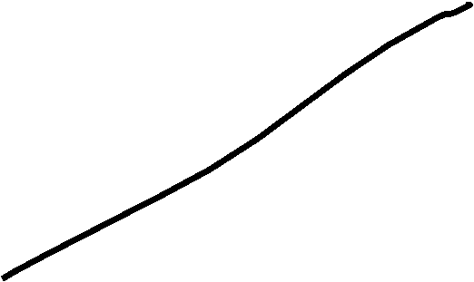






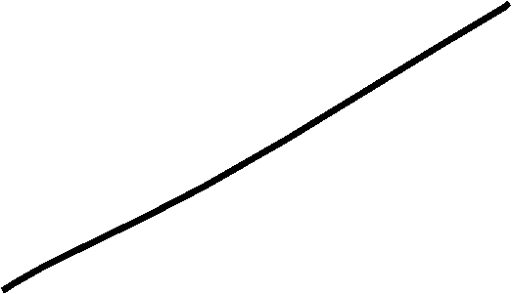








Slide 2














Slide 3













Slide 5






































Slide 6



































































Slide 7





















































Slide 16



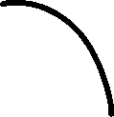



































Slide 17






























































Slide 18
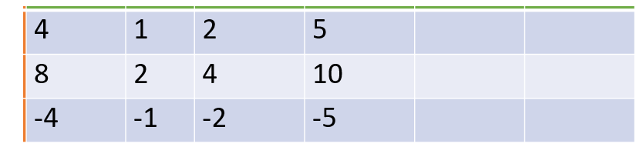




















































X(n)/h(n) | 4 | 1 | 2 | 5
1 | 4 | 1 | 2 | 5
2 | 8 | 2 | 4 | 10
-1 | -4 | -1 | -2 | -5

Slide 19


















































Slide 20
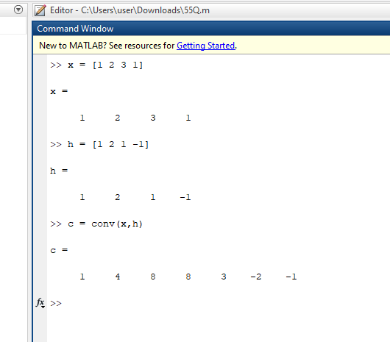
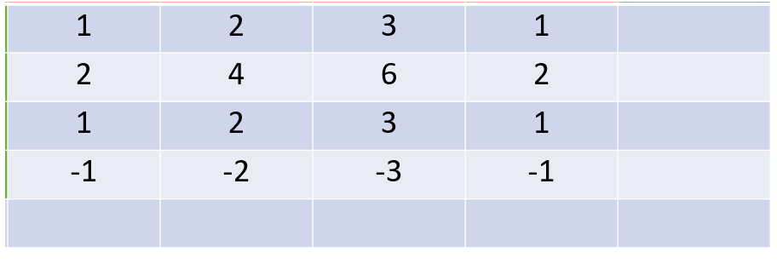





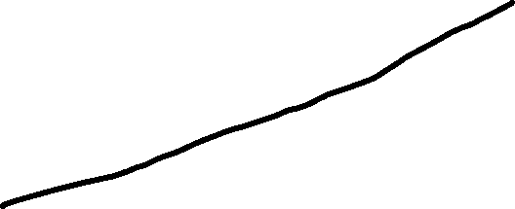

















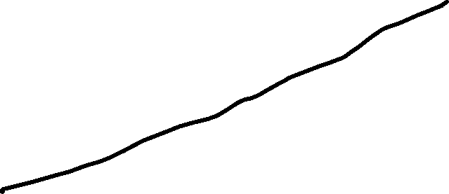









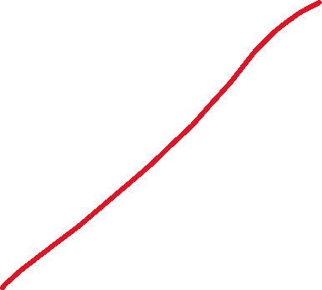
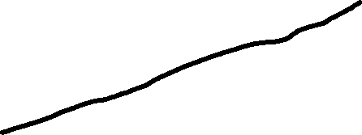








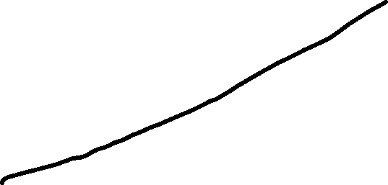




X(n)/h(n) | 1 | 2 | 3 | 1
1 | 1 | 2 | 3 | 1
2 | 2 | 4 | 6 | 2
1 | 1 | 2 | 3 | 1
-1 | -1 | -2 | -3 | -1

Slide 21





















Slide 22





























Slide 23
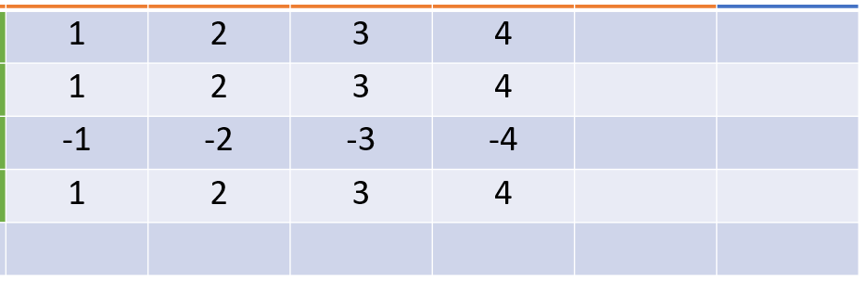

































X(n)/h(n) | 1 | 2 | 3 | 4
1 | 1 | 2 | 3 | 4
1 | 1 | 2 | 3 | 4
-1 | -1 | -2 | -3 | -4
1 | 1 | 2 | 3 | 4

Slide 24








































Slide 25






























































Slide 26













































Slide 27








































Slide 28

































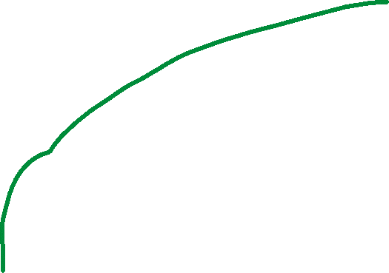









































Slide 29











Slide 30
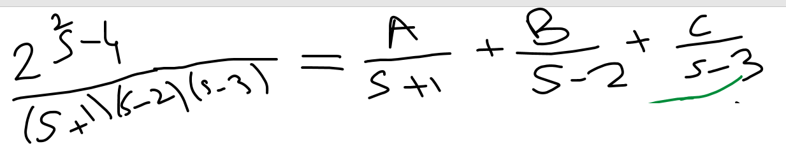


















































Slide 31





























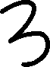

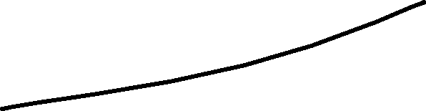





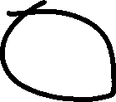




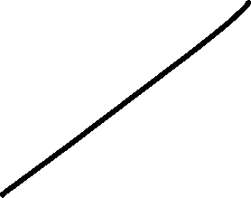









Slide 32



































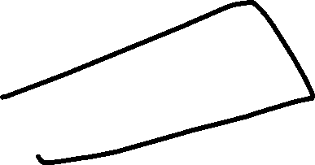



















Slide 33


















































